Slide 1
Week 3 – lesson 1

Slide 2
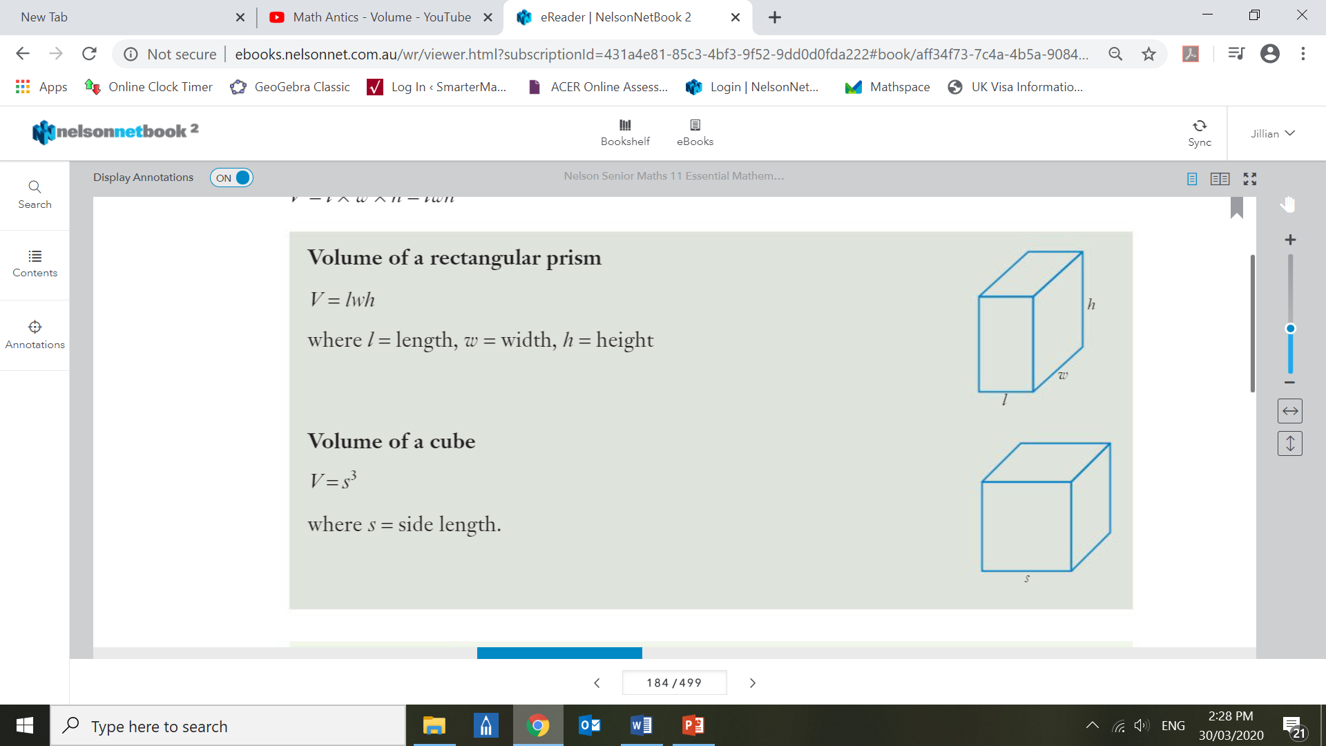
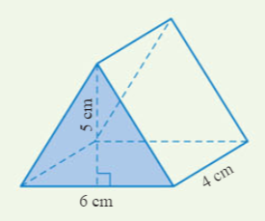
EQ: how do we calculate the volume of rectangular prisms?
TOPIC: measurement
What is a prism?
A prism is a solid object with:
identical ends
All faces are flat (no curves)
- the same cross section all along its length
Rectangular Prims Formula
Cube
Formula
Triangular prism
Formula
Volume = $lwh$
Volume = $s^{3}$
Volume = $\frac{1}{2} bh$

Slide 3
Week 3 – lesson 2

Slide 4
Week 3 – lesson 3

Slide 5
Week 3 – lesson 4

Slide 6
Mathematical Thinking Process Planning Sheet
Interpret the task
Identify the mathematics involved
Analyse information/data (you may need to use other sources)
Apply existing mathematical knowledge and strategies
Verify the reasonableness of your answer

